Slide 1
LINUX

Slide 2
What is LINUX?
Free and Open Source OS
Created by Linus Torvalds in 1991
Open source kernel
Notes:
OS: Much like Mac OS or Windows, only free.
Linus Torvalds: Knocked down the walls that had been put up by proprietary software giants!
Kernel: Links your hardware with applications. Being free and open source, allows it to be used for whatever application you want and on any device of your choice. A Windows or Mac OS cannot accomplish this. As such, we get to see a lot of use cases for Linux, such as, phones, refrigerators, Roku devices, IoT devices, Raspberry PI, etc.

Slide 3

Why LINUX?
Distros
Granular Control
Documentation/Resources/Communities
FREE!
Notes:
Distros: Or flavors. Thanks to the open source kernel, the open source community worldwide has produced a variety of distributions for Linux. One can pick and choose a flavor as per his/her requirements. For a normal desktop user, you could use the Ubuntu distro with the GUI. For server machines that you do not wish to overload with unnecessary stuff, you could use something like RHEL.
Granular Control: Linux focuses on security and stability compared to Windows which is more about ease of use. Some may argue that it is easy to operate on files and folder on Windows compared to a CLI. While this may seem to be true, a lack of GUI means that your machine runs faster, needs less power and can provide more resources to the task at hand rather than dealing with the graphics. However, it does have a learning curve to it and in case you are migrating from something like Windows, it will have an un-learning curve as well!
Documentation/Resources/Communities: There are tonnes of resources and documentation available for Linux whether you are new to the environment or want to dive deep. Also, being one of the most used OS, has created a lot of Linux user communities. Help, as such, is never far away!
FREE: To download, distribute, redesign and redistribute as your own, reuse on multiple systems(including web servers)-this when compared to a Windows server saves you so much money!

Slide 4
DEMO - LINUX

Slide 5
Windows
Mac OS
Download Putty
Download Link:
http://www.chiark.greenend.org.uk/~sgtatham/putty/download.html
Use the inbuilt Terminal

Slide 6
List of machines and users
Machine | User
10.29.19.6 | user1, user2, user3, user4, user5
10.29.19.10 | user6, user7, user8, user9, user10
10.29.19.11 | user11, user12, user13, user14, user15
10.29.19.196 | user16, user17, user18, user19, user20

Slide 7
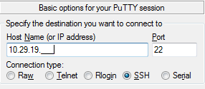
Logging in
Windows
Mac OS
Open Putty
Provide the IP address for your machine
Open Terminal and type the following command:
ssh username@10.29.19.__
Provide password as: classpass
Provide your username at “login as:”
Provide password as: classpass

Slide 8
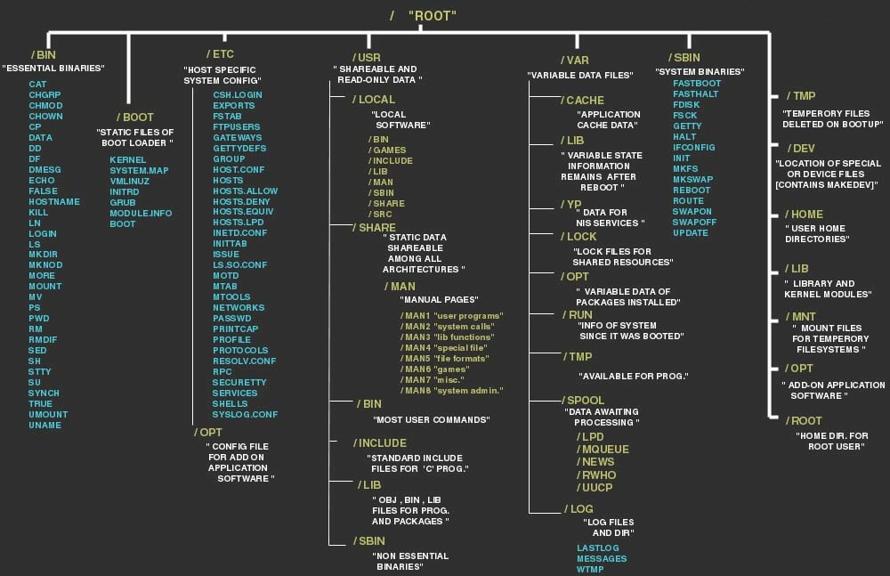
Linux file system

Slide 9
List of commands
Use | Command
Change password | passwd username
Manual | man
Check IP address | ifconfig
Clear screen | clear
Check path of current/working directory | pwd
List | ls
Change directory | cd directory_name //downward traversal
 | cd .. //level up
 | cd path //exact path to the directory
Use | Command
Make directory | mkdir directory_name
Remove directory | rm -r directory_name
Create a file(with editor) | vi filename
Write to the file(with vim) | Press “i” to start editing
Save file (with vim) | Esc→:wq
Abort file save(with vim) | Esc→:q!
Delete file | rm filename
Rename a file | mv o_filen new_file
 | cp o_filen new_file
Move a file | mv fname directory_name
Copy a file | cp fname directory_name
Check git version | git version
Notes:
--help: In addition to the above mentioned commands there are many additional options to each command. For instance, ls -l will list all the files with all the permissions. Using --help with the command name lists out all available option.
Eg. ls --help will list out all the possible list options available.
Rename/Move: both have the same command name

Slide 10
git

Slide 11
git - Overview

Slide 12
What is git?
(Distributed)Version Control System
Created by Linus Torvalds in 2005
Maintained by the Open Source Community
Notes:
VCS: Most widely used version control system. Distributed architecture unlike its predecessors like CVS and SVN. It checks versions by reading through the contents of the file rather than relying solely on the file name or change date

Slide 13
Basics
Used for:
Collaboration
Tracking changes
History documentation
Back up
Distributed version control
Notes:
Collaboration: Will be using this as the collaboration tool for this class. Also, extremely helpful if many people are working on the code as it gives you a clear line of sight as to who is making what changes. Minimizes duplication of work as you always know what is the latest changes.
Tracking changes: from one file to its updated version. Something similar to track changes in MS word. It marks and shows the exact places in the code that have been updated
History documentation: Keeps track of each and every commit where commit is the unit amount of work that has been done on the code. In case you want to go back to a previous version of the file(which always happens) you can simply trace back to that file and to the exact point in time.
Back up: Effective way to back up all your work as it is on cloud and readily accessible from any device.
Distributed version control: every person who is sharing the git repository has the complete access to the every file that is being tracked. Example: releasing a version 1.3.1 with bug fixes when there is already a version 2 in production

Slide 14
Workflow
Working Directory
Staging Area
.git directory(Repository)
Checkout the project
Stage Fixes
Commit
Checkout or Clone an existing project
Changes to this are added to the staging area
Staged files are committed to the local git database
Swierczewski
Notes:
Checkout/clone: gives you an exact copy with the complete history
Staging area: any changes made to the files they enter the staging are which basically shows all the changes that have been made from the previous state
Commit: If you are satisfied with the results above, you save the version on the file by committing which saves the files and updates the history with the changes that you have made on the file
Commit messages: Usually all the commits are accompanied with commit messages that a user can use to describe the work he/she has done on the code. This comes in really handy when you are looking back at your code after a few weeks and want to know what idea you were working on. Also, helps other people working on the same project to know where you left off and they can start continuing their work from there

Slide 15
DEMO - git

Slide 16
Configuring git on your machine
git config --global user.name “Your name here”
git config --global user.email emailid@iastate.edu
git config --global core.editor vi

Slide 17
Initializing your project
mkdir project_name
cd project_name
git init //initializing an empty directory with nothing to track
git status
Add a README file to your project
vi README.md //add description about your project
git add README.md //start tracking changes to the file
git status
git commit
git log //check the commits and changes that have been made to the file
Notes:
.md stands for Markdown. It is something that GitHub uses to format those files for its html view
A good commit messages: 50 chars or less to describe the changes you have made to the file
Issue Tracker: You can put references to the # of resolved issues if you have an issue tracker eg. Resolves #123
About the message on git commit:
[master (root-commit) eeda899] Initialize repository for Project_Name
- On the master branch(i.e. the root commit)
The number is a UID for that specific commit
Lists out the first 50 chars of your statement
1 files changed, 1 insertions(+), 0 deletions(-)
- 1 file was changed, 1 line was added and no deletions were made

Slide 18
Tracking changes
vi README.md //add some information on the file
git status
git diff //gives information about the changes that have been made since the last staging
git add README.md //send to staging area, ready to commit
git commit -m “Added how to” //easier way to commit if the commit message is less than 50 characters
Notes:
Git status: Now says “modified” rather than “added” because we are now tracking the file

Slide 19
GitHub

Slide 20
Remote repositories
Remotes allow collaboration, sharing and backup
Remote is any repository containing the same git database as your repository
Sharing commits = synchronizing repo databases
Sharing commits = pulling changes from other repos
Notes:
Remote: has the same timeline and same root of your timeline
Default configurations: No push permissions unless you own the project. If you want some changes to be added to someone else’s directory, they have to pull it from your repository. So you can push only to projects that you own.

Slide 21
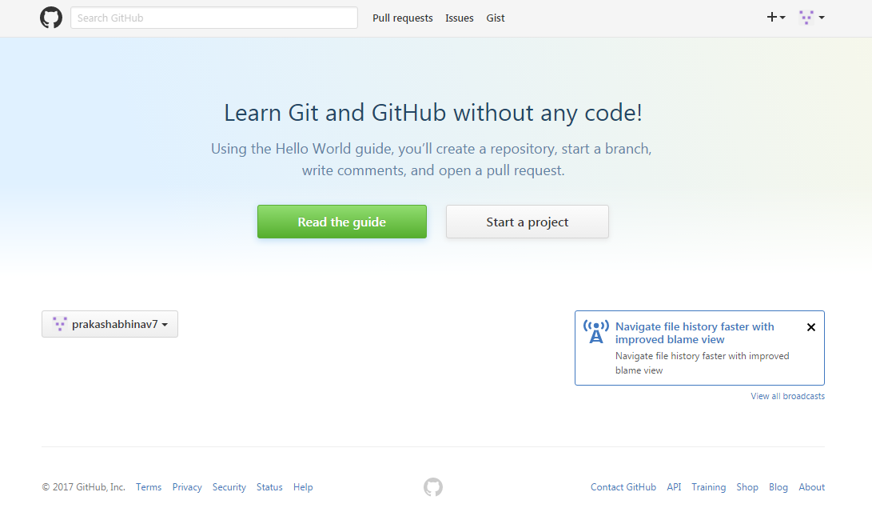
GitHub
Public repository:
On cloud
Easy access
Tools for collaboration:
Pull requests
Issues pages
Social networking
Notes:
Public repository or remote: A remote for anyone to view

Slide 22
DEMO - GitHub

Slide 23
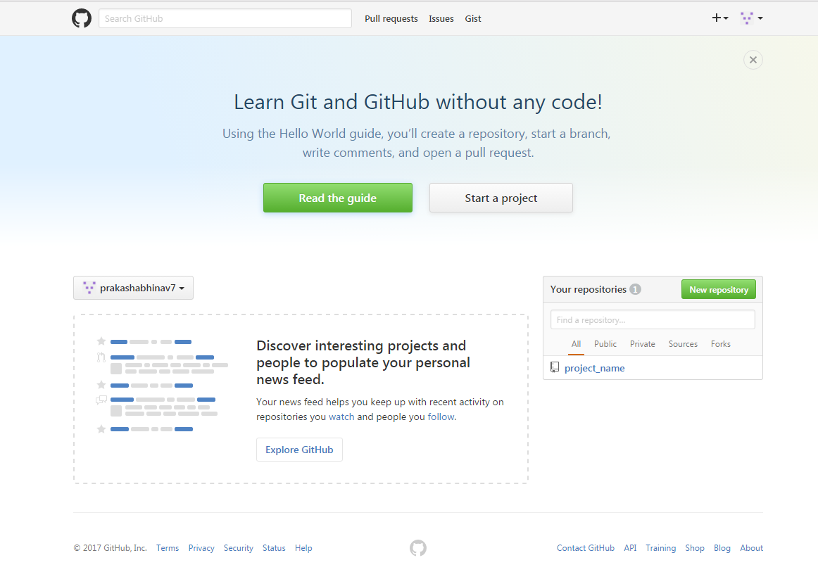
GitHub profile
Create GitHub profile:
github.com
Use your iastate id
Create repository:
Repository name
Description
Public
Do not check initialize with README.md
Create repository
Connection settings
Note the https://URL

Slide 24
Initializing remote connection
git remote add origin https://github.com/prakashabhinav7/project_name.git//Adding the remote
git remote –v //Returns the names of the repositories that are being tracked
Pushing the history tree to GitHub
git push -u https://prakashabhinav7@github.com/prakashabhinav7/project_name.git master //creates the replica on github of the local repository
Notes:
origin https://github.com/prakashabhinav7/project_name.git (push): Default repo to which all the push will push the code
Git push: Creates a new master at github which is the exact same replica of the one on the local
-u: It is for the first push where in it copies the entire tree from your local drive to github
Fork: one can fork a project(say it is named PQ) from someone’s github repo to create a public copy of PQ to which this new user will have push/pull privileges i.e. ownership of the (forked)repo

Slide 25
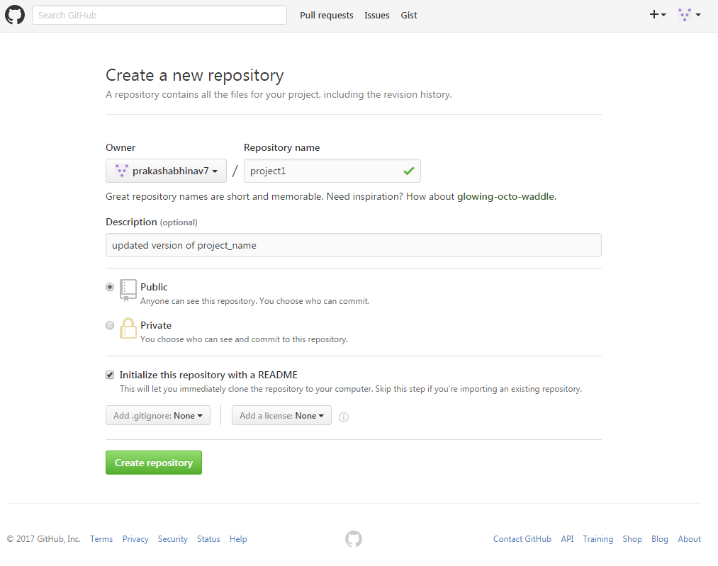
Cloning
Create repo in GitHub
Repository name
Description
Public
Initialize with README.md
Create repository
Notes:
Cloning: an existing repository from github

Slide 26
contd.
Clone it in your local machine
Clone it with https //get the https:URL
git clone https://github.com/prakashabhinav7/project1.git
git remote -v //check if the latest repo is updated on your machine
git log

Slide 27
Branching
Most powerful feature of git
Allows testing without affecting your “working” code
Facilitates code contribution when multiple developers are working on the same code
Master branch: used as the last “working” state

Slide 28
Branching contd..
HEAD
master
C0
C1
C2
Swierczewski
Notes:
Structure:
C0 was the first commit post which we have added more commits
HEAD points to our current location // in this case it refers to the most recent commit that we have made
master is the branch label associated with this commit

Slide 29
Branching contd..
HEAD
master
C0
C1
C2
issue10
$ git branch issue10
Swierczewski
Notes:
$ git branch issue10 : creates a new branch that points, by default, to the recent most commit

Slide 30
Branching contd..
master
C0
C1
C2
issue10
$ git checkout issue10
HEAD
Swierczewski
Notes:
$ git checkout issue10 : moves to the new identical branch “issue10”. For this it moves the head pointer to the issue10

Slide 31
Branching contd..
master
C0
C1
C2
C3
issue10
$ vi README.MD
$ git commit -a -m “working on issue 10”
HEAD
Swierczewski
Notes:
$ vi README.md : make some changes to the README.md file
$ git commit -a -m “working on issue 10” : make a new commit C3. The pointer now shifts to the most recent commit i.e. C3 and also since we are working on the issue10 branch, the issue10 pointer now points to C3 as well

Slide 32
Branching contd..
HEAD
master
C0
C1
C2
C3
$ git checkout master
issue10
Swierczewski
Notes:
$ git checkout master : moves the HEAD pointer to the master and to the state C2

Slide 33
Branching contd..
git branch //lists the branches available
git branch issue10 //creates a new branch with the name issue10
git checkout issue10 //switches to the issue10 branch
Committing changes to the new branch
vi README.md//change the file on issue10 branch
git add README.md//start tracking the file on the new branch
git commit -m “more text added”//make a commit to the new branch
Notes:
git branch: returns the branches that are available and a * is used to indicate the current branch
git checkout issue10: returns a message that you have switched to the issue10 branch. Using the “git branch” command now shows the issue10 branch with the * i.e. the current working directory
Pointer: right now both master and issue10 point to the same commit //can check this with the commit id
git checkout master: switches back to the master, however, checking the recent most commit with git log shows that this branch has not been affected by our recent most addition to the issue10 README.md file

Slide 34
Branching contd..
HEAD
newfix
master
C4
C0
C1
C2
C3
issue10
$ git checkout -b newfix
$ vi README.md
$ git commit -a -m “more fixes”
Swierczewski
Notes:
$ git checkout -b newfix: shortcut for $ git branch newfix followed by $ git checkout newfix
$ vi README.md: Making changes on the newfix branch
$ git commit -a -m “more fixes”: Add to tracking and add a commit message

Slide 35
Merging
Git operation to merge changes between branches
Types of merge
Fast-forward(quick)//only moves the branch/commit pointer
Auto(harder)//does not involve just moving the pointer

Slide 36
Merging contd..
HEAD
1. Fast-forward
newfix
master
C4
C0
C1
C2
C3
issue10
Merge the changes of the newfix(C4) onto the master branch
$ git checkout master
$ git merge newfix
Swierczewski
Notes:
Merging changes from newfix to master branch: is as simple as moving the master branch up the tree and

Slide 37
Merging contd..
HEAD
master
newfix
C4
C0
C1
C2
C3
issue10
Swierczewski

Slide 38
Merging contd..
HEAD
master
C4
C0
C1
C2
C3
issue10
Delete the newfix(C4) branch once the changes have been merged to master
$ git branch -d newfix
$ git branch
Swierczewski

Slide 39
Merging contd..
2. Normal
master
C0
C1
C2
C4
$ git checkout issue10
$ git branch
Make a new file on issue10 branch with vi “hello.py”
$ git status //shows that we have an untracked file on the branch
$ git add hello.py
$ git commit -m "New python file"
C3
C5
issue10
HEAD
Swierczewski
Notes:
git log --decorate --all
git log --decorate --all --graph
git log --decorate --all --graph --oneline

Slide 40
Merging contd..
HEAD
2. Auto-merge
master
C0
C1
C2
C4
C6
$ git checkout master
$ git branch
$ git merge issue10
(later) $ git branch -d issue10
C3
C5
issue10
Swierczewski
Notes:
The pointer in this cannot be just moved forward because they are on different timelines.
They have a common ancestor at C2.
git takes all the changes from the common ancestor point till C5 and does a “merge commit”

Slide 41
$ git push
Notes:
Update your GitHub repo

